Slide 1
Tanzanian Water Supply
Presented by: Philip Neuhart
Last updated: 05.10.22

Slide 2
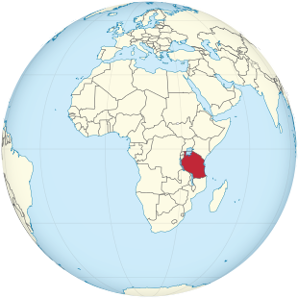
Tanzania
Population: 59 Million

Slide 3
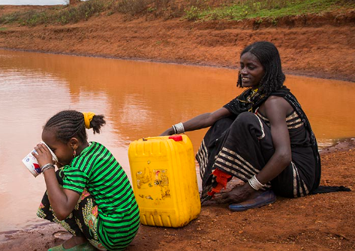
Tanzania
Population: 59 Million
4 million people in Tanzania lack access to an improved source of safe water.¹
1) https://water.org/our-impact/where-we-work/tanzania
https://www.lifewater.org

Slide 4
Tanzania
Population: 59 Million
4 million people in Tanzania lack access to an improved source of safe water.¹
29 million don't have access to improved sanitation.¹
1) https://water.org/our-impact/where-we-work/tanzania
https://www.lifewater.org

Slide 5
Table of Contents

Slide 6
Table of Contents
Project Goals and Data

Slide 7
Table of Contents
Project Goals and Data
Findings

Slide 8
Table of Contents
Project Goals and Data
Findings
Strategy

Slide 9
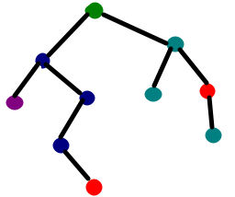
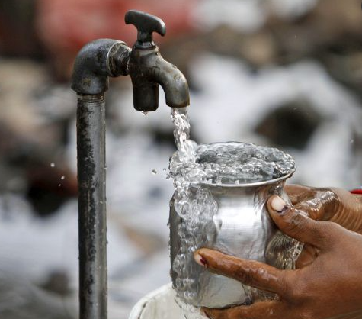

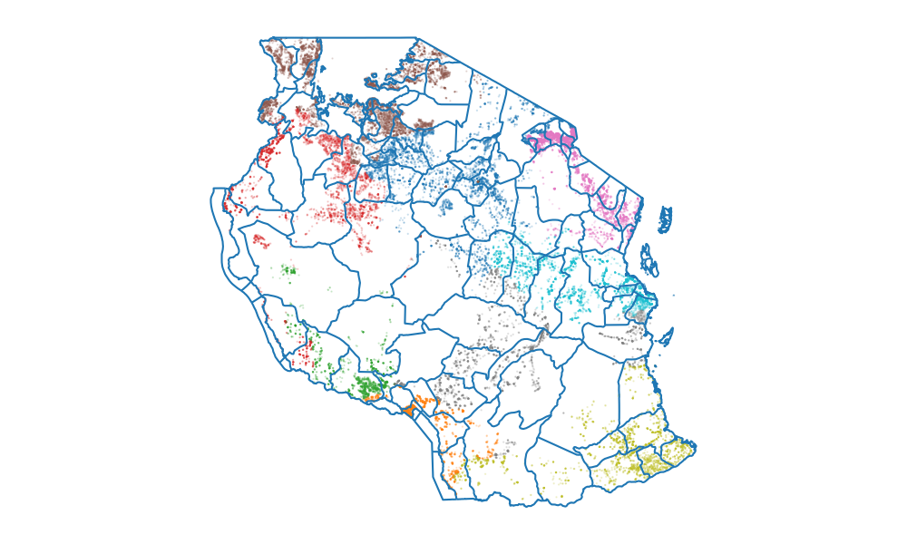
Goals

Slide 10
Goals
Increase access to clean water

Slide 11
Goals
Increase access to clean water
Develop an effective strategy to battle water shortages

Slide 12
Goals
Increase access to clean water
Develop an effective strategy to battle water shortages
Focus on time- and cost-efficient solutions

Slide 13
Data

Slide 14
Data
Provided by: Taarifa waterpoints dashboard

Slide 15
Data
Provided by: Taarifa waterpoints dashboard
Collected between 2011 and 2013

Slide 16
Data
Provided by: Taarifa waterpoints dashboard
Collected between 2011 and 2013
Content: geographic, economic, demographic and technical data corresponding to water pumps in Tanzania

Slide 17
Data
Provided by: Taarifa waterpoints dashboard
Collected between 2011 and 2013
Content: geographic, economic, demographic and technical data corresponding to water pumps in Tanzania
Including status of water pumps:
Functional
Functional but in need of repair
Non-functional

Slide 18
Data
Provided by: Taarifa waterpoints dashboard
Collected between 2011 and 2013
Content: geographic, economic, demographic and technical data corresponding to water pumps in Tanzania
Including status of water pumps:
Functional
Functional but in need of repair
Non-functional
Data quality: Improvable

Slide 19
Findings

Slide 20
Table of Contents
Project Goals and Data
Findings

Slide 21
Table of Contents
Project Goals and Data
Findings
How are the waterpoints distributed?

Slide 22
Table of Contents
Project Goals and Data
Findings
How are the waterpoints distributed?
Which factors contribute to non-functional water pumps?

Slide 23
Table of Contents
Project Goals and Data
Findings
How are the waterpoints distributed?
Which factors contribute to non-functional water pumps?
Impact of water pump funders

Slide 24
How are the waterpoints distributed?

Slide 25
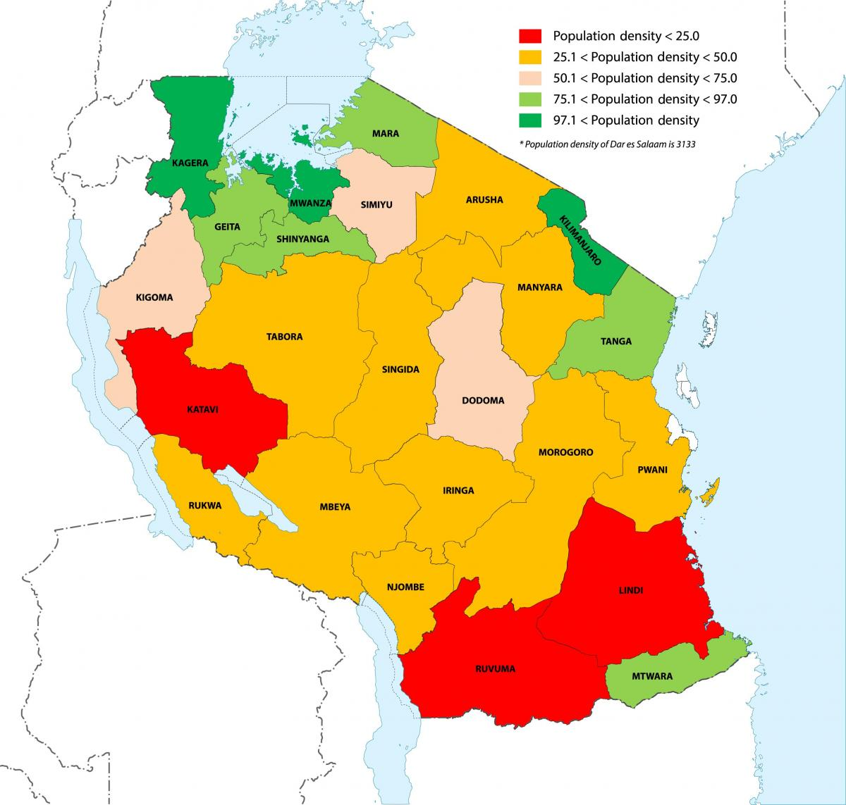
Population Density

Slide 26
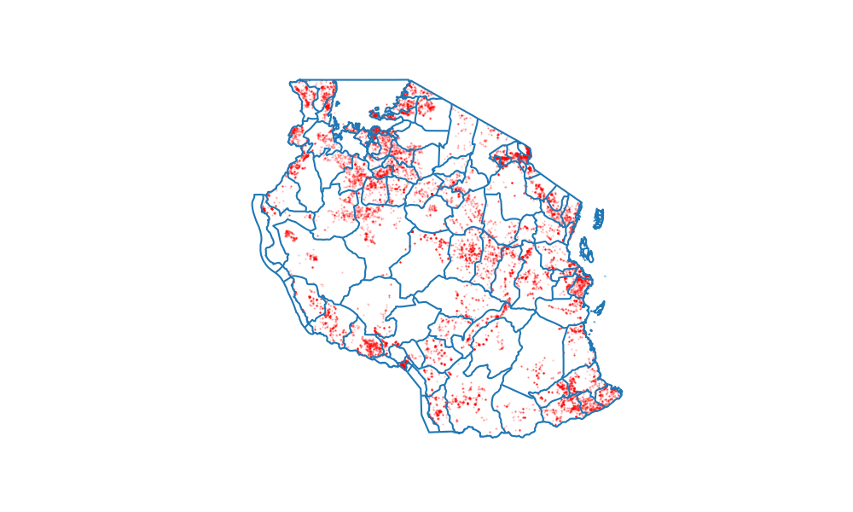

Slide 27
Non-functional water pumps

Slide 28
Clusters of non-functional water pumps

Slide 29
Clusters of non-functional water pumps
Lake Victoria basin most affected

Slide 30
Clusters of non-functional water pumps
Lake Victoria basin most affected
Focus on densely populated regions

Slide 31
Which factors contribute to non-functional water pumps?

Slide 32
Status prediction

Slide 33
Status prediction
Use machine learning algorithm on data to extract knowledge

Slide 34
Status prediction
Use machine learning algorithm on data to extract knowledge

Slide 35
Status prediction
Use machine learning algorithm on data to extract knowledge

Slide 36
Status prediction
Use machine learning algorithm on data to extract knowledge

Slide 37
Status prediction
Use machine learning algorithm on data to extract knowledge
78% Accuracy

Slide 38
How is this helping?

Slide 39
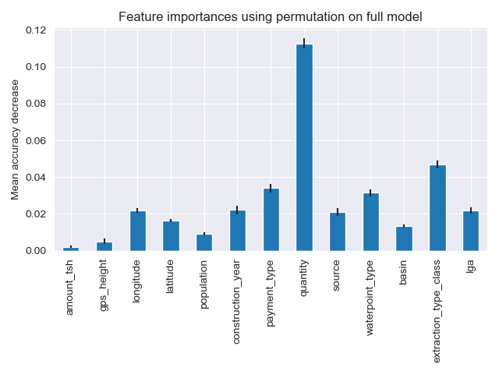

Slide 42
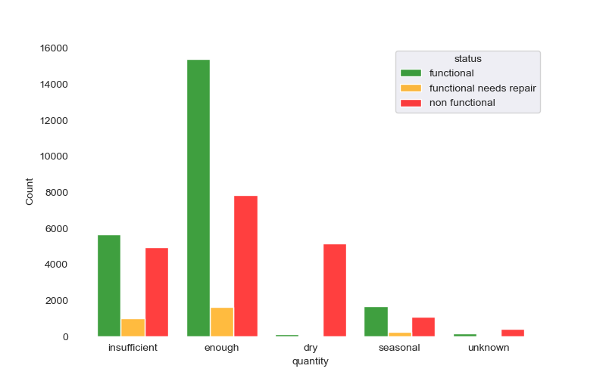
Water Quantity

Slide 43
Water Quantity
Number of data entries
Categories of Feature

Slide 44
Water Quantity
Almost all water pumps at dry waterpoints are labeled as non-functional

Slide 45
Water Quantity
Almost all water pumps at dry waterpoints are labeled as non-functional
High percentage of non-functional water pumps at waterpoints with insufficient water

Slide 46
Water Quantity
Almost all water pumps at dry waterpoints are labeled as non-functional
High percentage of non-functional water pumps at waterpoints with insufficient water
Water pumps are likely still functional

Slide 47
Water Quantity
Almost all water pumps at dry waterpoints are labeled as non-functional
High percentage of non-functional water pumps at waterpoints with insufficient water
Water pumps are likely still functional
Focus on restoring water supply in dry areas

Slide 48
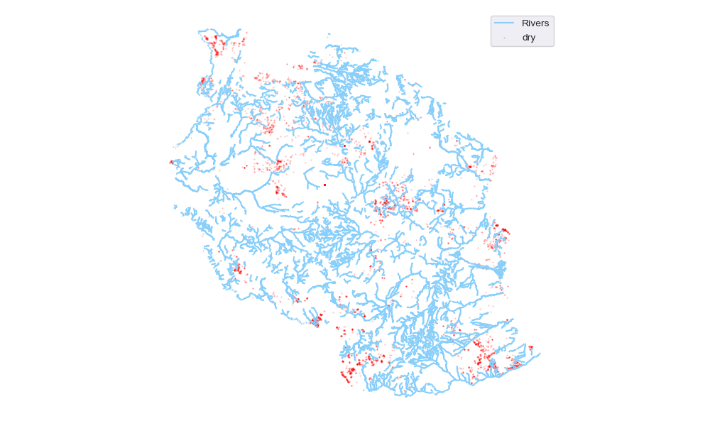
Water Quantity

Slide 49
Water Quantity
Dry waterpoints are clustered

Slide 50
Water Quantity
Dry waterpoints are clustered
Mostly located in areas without rivers

Slide 51
Water Quantity
Dry waterpoints are clustered
Mostly located in areas without rivers
Invest in water infrastructure

Slide 52
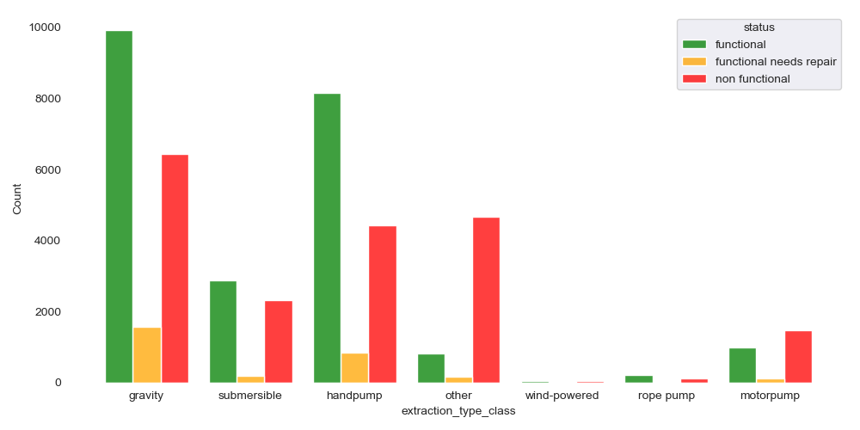
Extraction Type

Slide 53
Extraction Type
Improve data collection process

Slide 54
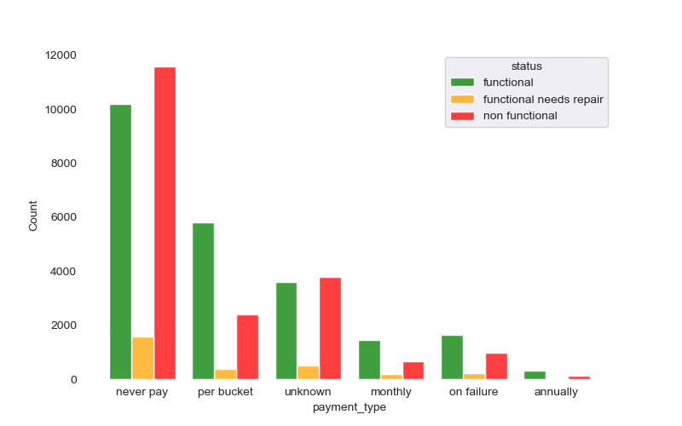
Water Costs

Slide 55
Water Costs

Slide 56
Water Costs
Create water pump maintenance jobs

Slide 57
Water Costs
Create water pump maintenance jobs
Introduce payment systems

Slide 58
Impact of water pump funders

Slide 59
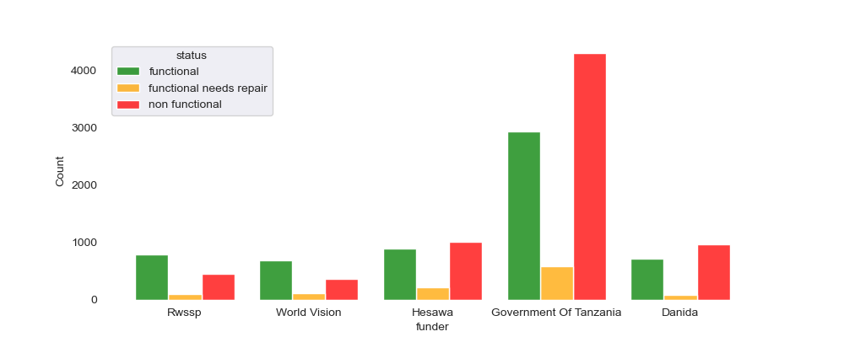
Top Funders

Slide 60
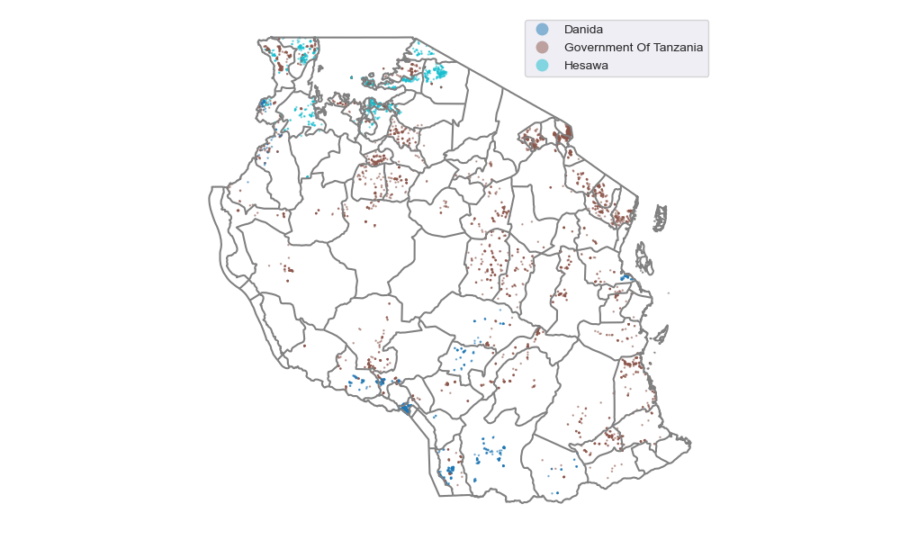
Top Funders

Slide 61

Government of Tanzania

Slide 62
Government of Tanzania

Slide 63
Government of Tanzania
Predominantly active in the east of Tanzania

Slide 64
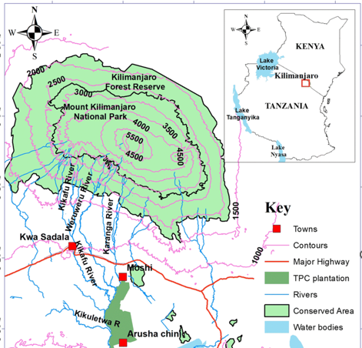
Government of Tanzania
Predominantly active in the east of Tanzania

Slide 65
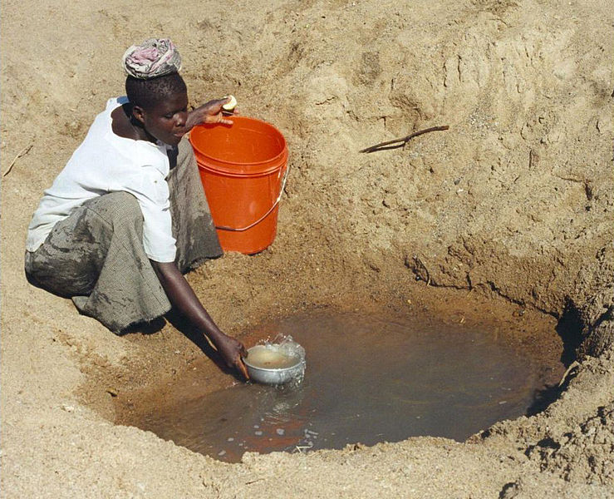
Government of Tanzania
Source | Count | Functioning (%)
Spring | 3354 | 54.4
Borehole | 1337 | 36.7
Shallow Well | 1229 | 38.7
River | 1045 | 43.6
https://www.water-technology.net

Slide 66
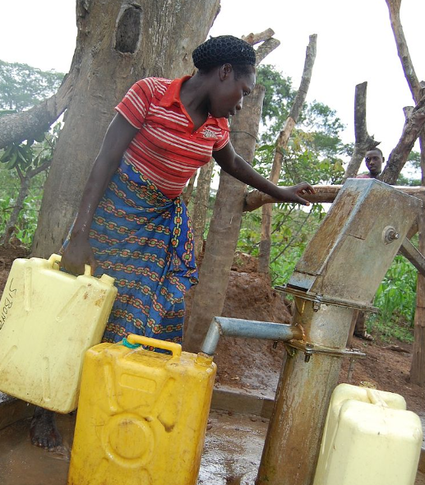
Government of Tanzania
Source | Count | Functioning (%)
Spring | 3354 | 54.4
Borehole | 1337 | 36.7
Shallow Well | 1229 | 38.7
River | 1045 | 43.6
https://www.water-technology.net

Slide 67
Government of Tanzania
Source | Count | Functioning (%)
Spring | 3354 | 54.4
Borehole | 1337 | 36.7
Shallow Well | 1229 | 38.7
River | 1045 | 43.6
Low rate of functioning wells

Slide 68
Government of Tanzania
Source | Count | Functioning (%)
Spring | 3354 | 54.4
Borehole | 1337 | 36.7
Shallow Well | 1229 | 38.7
River | 1045 | 43.6
Low rate of functioning wells
Largest funder of water pumps

Slide 69
Government of Tanzania
Source | Count | Functioning (%)
Spring | 3354 | 54.4
Borehole | 1337 | 36.7
Shallow Well | 1229 | 38.7
River | 1045 | 43.6
Low rate of functioning wells
Largest funder of water pumps
Focus on Kilimanjaro region

Slide 70
Government of Tanzania
Source | Count | Functioning (%)
Spring | 3354 | 54.4
Borehole | 1337 | 36.7
Shallow Well | 1229 | 38.7
River | 1045 | 43.6
Low rate of functioning wells
Largest funder of water pumps
Focus on Kilimanjaro region
Use water resources of Kilimanjaro

Slide 71
Hesawa – Health through Sanitation and Water

Slide 72
Hesawa – Health through Sanitation and Water
Predominantly active in densely populated regions

Slide 73
Hesawa – Health through Sanitation and Water
Predominantly active in densely populated regions

Slide 74
Hesawa – Health through Sanitation and Water
Predominantly active in densely populated regions
Waterpoints less affected by dryness

Slide 75
Hesawa – Health through Sanitation and Water
Source | Count | Functioning (in %)
Shallow Well | 1484 | 48.3
Spring | 317 | 64.7
Borehole | 114 | 57.0
Rainwater Harv. | 112 | 56.2
Predominantly active in densely populated regions
Waterpoints less affected by dryness

Slide 76
Hesawa – Health through Sanitation and Water
Source | Count | Functioning (in %)
Shallow Well | 1484 | 48.3
Spring | 317 | 64.7
Borehole | 114 | 57.0
Rainwater Harv. | 112 | 56.2
Predominantly active in densely populated regions
Waterpoints less affected by dryness
Mostly funded shallow wells

Slide 77
Hesawa – Health through Sanitation and Water
Predominantly active in densely populated regions
Waterpoints less affected by dryness
Mostly funded shallow wells
Cooperate more closely with Hesawa

Slide 78
Hesawa – Health through Sanitation and Water
Predominantly active in densely populated regions
Waterpoints less affected by dryness
Mostly funded shallow wells
Cooperate more closely with Hesawa
Measure groundwater levels

Slide 79

Danida – Danish International Development Agency

Slide 80
Danida – Danish International Development Agency
Mostly active in regions with low population density

Slide 81
Danida – Danish International Development Agency
Mostly active in regions with low population density
Highly effected by dryness

Slide 82
Danida – Danish International Development Agency
Source | Count | Functioning (%)
Spring | 880 | 35.6
River | 443 | 55.5
Shallow Well | 261 | 58.2
Borehole | 144 | 46.5
Mostly active in regions with low population density
Highly effected by dryness

Slide 83
Danida – Danish International Development Agency
Source | Count | Functioning (%)
Spring | 880 | 35.6
River | 443 | 55.5
Shallow Well | 261 | 58.2
Borehole | 144 | 46.5
Mostly active in regions with low population density
Highly effected by dryness
Low rate of functioning waterpoints built on springs

Slide 84
Danida – Danish International Development Agency
Source | Count | Functioning (%)
Spring | 880 | 35.6
River | 443 | 55.5
Shallow Well | 261 | 58.2
Borehole | 144 | 46.5
Mostly active in regions with low population density
Highly effected by dryness
Low rate of functioning waterpoints built on springs
Cooperate more closely with Danida

Slide 85
Danida – Danish International Development Agency
Source | Count | Functioning (%)
Spring | 880 | 35.6
River | 443 | 55.5
Shallow Well | 261 | 58.2
Borehole | 144 | 46.5
Mostly active in regions with low population density
Highly effected by dryness
Low rate of functioning waterpoints built on springs
Cooperate more closely with Danida
Invest in water infrastructure

Slide 86
Strategy

Slide 87
Strategy

Slide 88
Strategy
Focus on Lake Victoria and Kilimanjaro regions

Slide 89
Strategy
Focus on Lake Victoria and Kilimanjaro regions
Invest in water infrastructure to guarantee water supply

Slide 90
Strategy
Focus on Lake Victoria and Kilimanjaro regions
Invest in water infrastructure to guarantee water supply
Ensure maintenance of pumps through payment options or job creations

Slide 91
Strategy
Focus on Lake Victoria and Kilimanjaro regions
Invest in water infrastructure to guarantee water supply
Ensure maintenance of pumps through payment options or job creations
Intensify cooperation with other organizations (e.g.: Hesawa, Danida)

Slide 92
Strategy
Focus on Lake Victoria and Kilimanjaro regions
Invest in water infrastructure to guarantee water supply
Ensure maintenance of pumps through payment options or job creations
Intensify cooperation with other organizations (e.g.: Hesawa, Danida)
Improve monitoring process of waterpoints

Slide 93
Thank you!

